Slide 1

Data Science & Machine Learning L1 & L2 regularization

Slide 2



Example: Linear regression
Price ($) in 1000’s
Price ($) in 1000’s
Price ($) in 1000’s
Size in feet^2
Size in feet^2
Size in feet^2
$$h_{θ}\left(x\right)=θ_{0}+θ_{1}x$$
$$h_{θ}\left(x\right)=θ_{0}+θ_{1}x+θ_{2}x^{2}$$
$$h_{θ}\left(x\right)=θ_{0}+θ_{1}x+θ_{2}x^{2}+ \\ { θ}_{3}x^{3}+θ_{4}x^{4}+⋯$$
Underfitting
Just right
Overfitting
High bias
High variance

Slide 3
Bias-Variance Tradeoff
Bias: difference between what you expect to learn and truth
Measures how well you expect to represent true solution
Decreases with more complex model
Variance: difference between what you expect to learn and what you learn from a particular dataset
Measures how sensitive learner is to specific dataset
Increases with more complex model

Slide 4
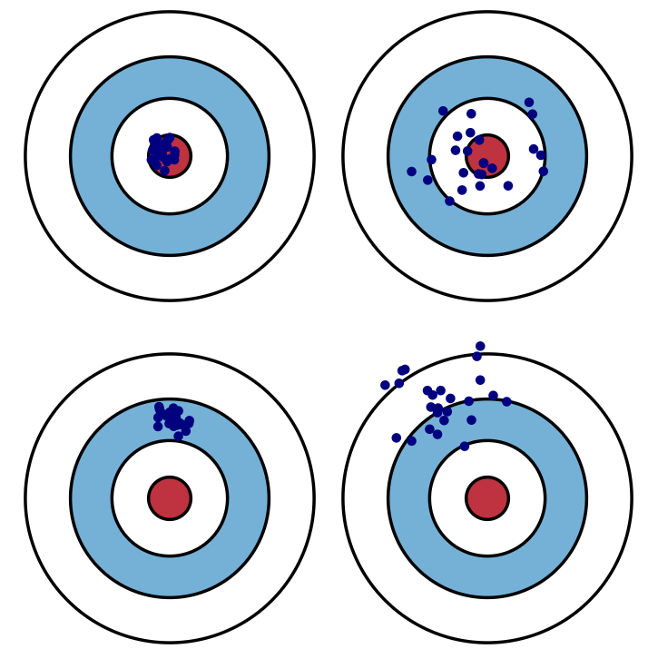
Low variance
High variance
Low bias
High bias

Slide 5
L1 regularization
(also called Lasso
regularization/ penalization.)
L1 regularization is the preferred choice when having a high number of features as it provides sparse solutions. Even, we obtain the computational advantage because features with zero coefficients can be avoided.
The regression model that uses L1 regularization technique is called Lasso Regression.

Slide 6
L2 regularization
(also called Ridege regularization/ penalization.)
L2 regularization, or the L2 norm, or Ridge (in regression problems), combats overfitting by forcing weights to be small, but not making them exactly 0.
L2 regularization returns a non-sparse solution since the weights will be non-zero (although some may be close to 0).

Slide 7
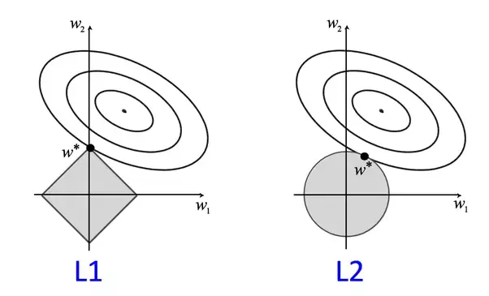

Slide 8
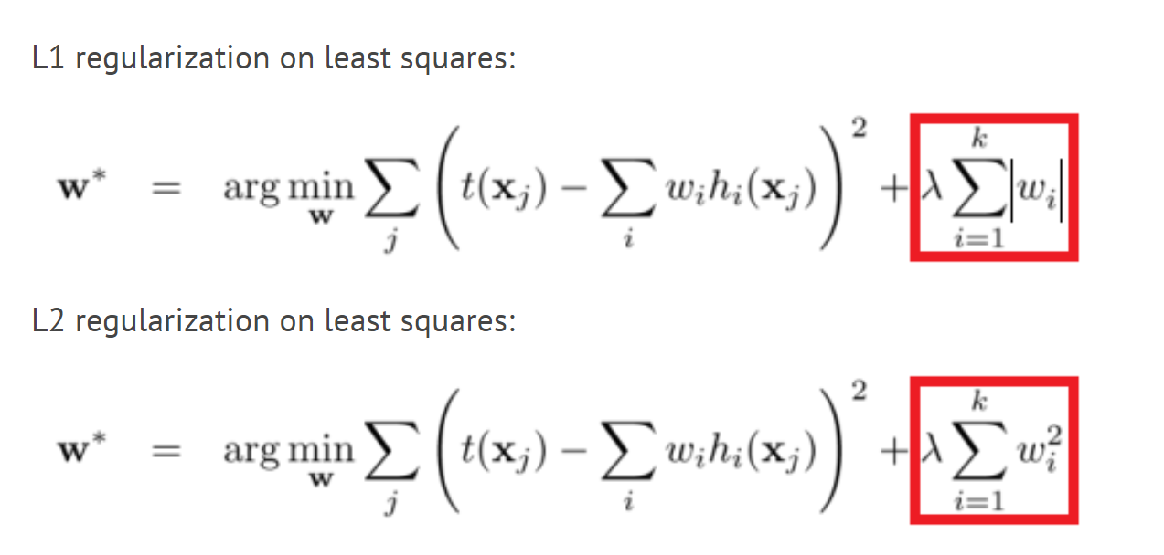

Slide 9
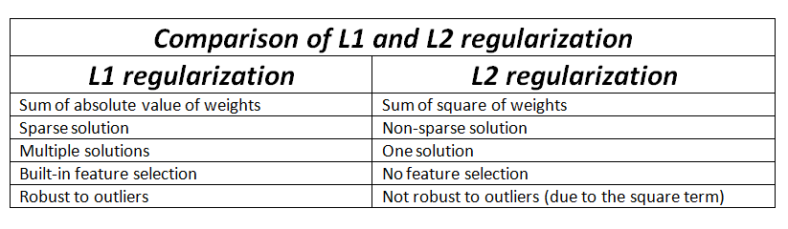

Slide 10
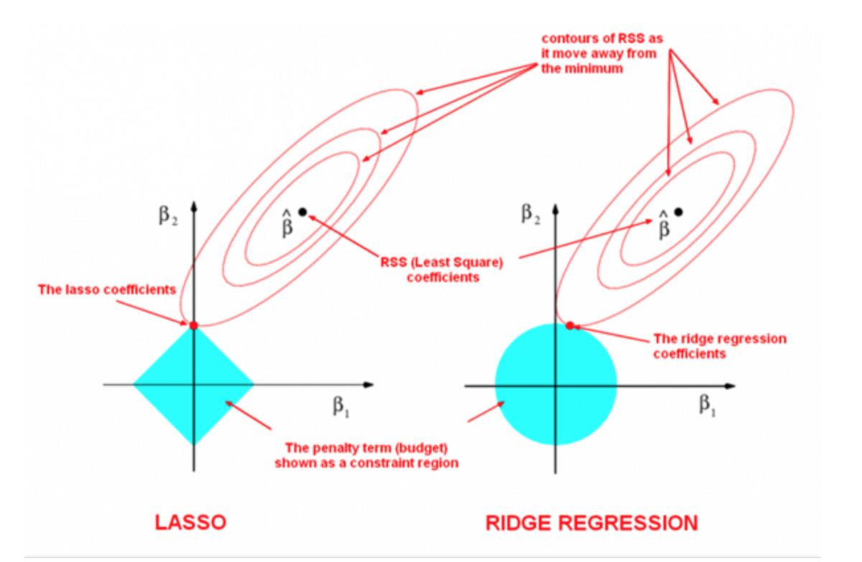

Slide 11
Goals for next meeting
L2 and L1 Regularization

